Slide 1
Predicting the outcome of UFC fights
By: Taylor Moorman

Slide 2

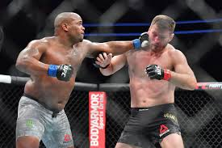
What is the UFC?
Largest MMA Promotion in the world
Founded in 1993
On track to promote 43 events in 2019
Worth over 7 billion dollars

Slide 3
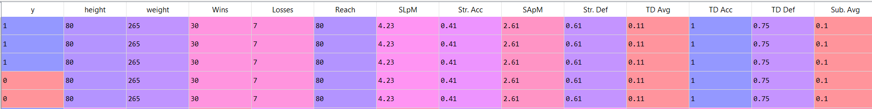
Data Sources
2 from Sherdog.com
Fights.xlsx
Fighter.xlsx
1 from Fightmetric
Fightmetric.xlsx
Transformed, cleaned, joined together to create finalset

Slide 4


Questions
Can UFC fights be accurately predicted?
Beating Vegas Odds
What features are the most important in determining the outcome of UFC fights?
Height?
Weight?
Age?
Stance?
Nationality?

Slide 5
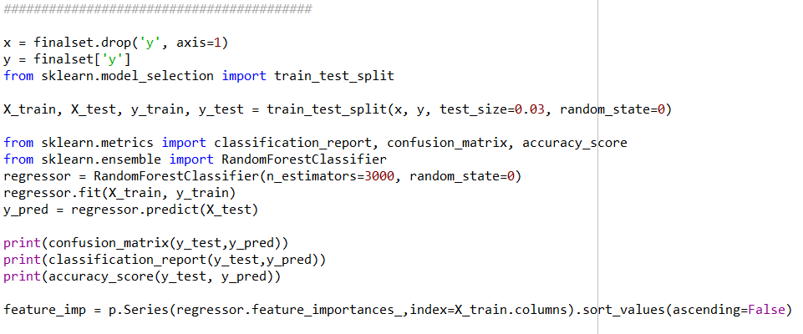
Program Overview
Reads and transforms dataset to create finalset
Discretizes and created calculated columns
Trains and tests RandomForest model
Determines Feature Importance
Creates Confusion Matrix

Slide 6
Findings: Model
Confusion Matrix: [[42 30]
[32 58]]
Metrics: precision recall f1-score support
0 0.57 0.58 0.58 72
1 0.66 0.64 0.65 90
avg / total 0.62 0.62 0.62 162
Model Accuracy: 61.73%

Slide 7
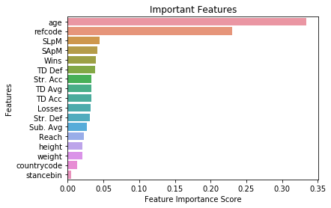
Findings: Feature Importance
Important Features
Age
Referee
Significant Strikes Landed per Minute
Significant Strikes Absorbed per Minute
Wins

Slide 8
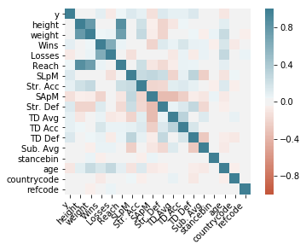
Findings: Confusion Matrix
Important Features
Age
SLpM
SApM
Wins
TD Def

Slide 9
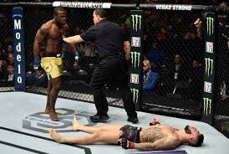

Conclusion
Model Accuracy = KO
BUT still beat Vegas odds
Possible to find important features that can help give insight
Can’t Quantify
Heart
Grit
Determination
Injuries

